Slide 1
DISS
A JVS Overview
Rebecca Devore
Security Representative Associate

Slide 2
Objective
DISS vocabulary
Provisioning
Hierarchy structure
CSR submissions and Notifications
Uploading SF312 (Non-Disclosure Agreements)
What we have learned
National Industrial Security System (NISS) Transition Plan
Locations to find help

Slide 3
remarks
There are different levels of understanding when it comes to DISS and JVS. This slide pack has been tailored to a common understanding.
Please keep in mind the information on the slides reflect what Lockheed Martin and the DISS working group have been addressing based on instructions received from the PSMO-I (VROC), as well knowledge sharing amongst contractors.

Slide 4
DISS Vocabulary
DISS Defense Information System for Security
JVS Joint Verification System
CSR Customer Service Request (replaces RRUs)
RFA Request for Action (replaces DoD CAF messages)
Subject Details Select Person (same information from JPAS screen)

Slide 5
Provisioning
KMP and Account Managers should have received an email about being auto-provisioned into DISS.
When completing the PSSARs ensure the form is completed correctly.
Of those submitted 260 have been approved 525 have been rejected.
The authorizing KMP should be cleared in conjunction with the FCL.
If you are not sure how to complete the request there is an option on the DMDC phone tree for assistance.
DISS is working toward all provisioning to be complete by November 1st.

Slide 6
Hierarchy Structure
We recommend reaching out to DMDC Contact Center to have them send you a copy of your hierarchy.
We also recommend you clean you your SMO codes before you have them pushed to DISS.
Once they are in there it takes a while to get them removed
If you your hierarchy is inaccurate, you have to submit a HCR (Hierarchy change request) and submit it to DSS PSMO-I with the subject line: DISS HCR-”Your Company Name”
DISS has released a “Tips and Tricks” PowerPoint on the DSS website that has this information as well as where to send the HCR.
Hierarchy managers are responsible for maintaining and updating the information contained in each SMO.
Reminder: Cage Codes are already in the system, they just need to be assigned to your organization.

Slide 7
CSR submissions
A document is required for all CSR submissions.
Word document with your request
Comments section-brief description and a POC
Not all CSR options are available
Verify owning relationship
Supplemental information
Make sure you use the “DoD IND” option and submit to the right place. (DoD CAF)

Slide 8
How to submit a CSR
Click on subject details
This brings you into the actual record of the individual
On Basic Info tab a green dropdown will appear
Subject Actions
Click on the CSR you are trying to submit (not all CSRs are available)
Can use Supplemental Information as a catch all
When the CSR has been submitted
The system will take you back to the ‘about JVS” tab
Navigate to the subject details tab and refresh the tab
Navigate to the CSR/RFA tab and your submission should be there under the CSR option

Slide 9
Notifications
Communications tab
Notifications of SF312 approvals and rejects
Subject detail updates
RFA notifications from the government
This also contains a task inbox:
This is where some but not all actionable items will come in
Ability to assign individuals with tasks is here and this is how the actions can be worked.
Note: the DoD CAF will send letter and notifications through DISS
Most letters will request the subject’s relationship be established
Contact the DoD CAF to let them know the relationship is in the system, should resolve issue

Slide 10
Uploading SF312s
NDA will show in JVS once entered into JPAS.
Can real-time load SF312s but JPAS will not push for at least 3 days
To upload the SF312 click under subject details
Access tab
Green box will appear to upload
Max on file size
If no green box is present, check the category on the main page. If there is not a category in JVS but you have a relationship in JPAS, contact DMDC.

Slide 11
What we’ve learned
Near to real time = 3 days
If you don’t know, call (we are frequent callers to DMDC)
Track, track, track

Slide 12
Locations to find help
Recommended CDSE STEPP Training Courses
DISS Portal (EX101.16)
DISS Hierarchy Management (EX100.16)
When you log into DISS there is a help link that will take you to the user guide.
http://www.dss.mil/index.html DSS homepage for any updates (August 20th News DISS tips and tricks) Very helpful

Slide 13
DSS notification of interest
The next slide was information that can be located on the DSS website that we felt you may need to know. A full article of the NISS transition plan can be found there and we recommend you go over to see how this could impact your organization.

Slide 14
NISS Transition Plan
On September 5th DSS posted the timelines for NISS deployment.
Monday, September 17 – Friday, September 28 – Facility Clearance Verifications in ISFD
Monday, October 1 – Friday, October 5 – Clearance Verifications Submitted to DSS Knowledge Center
Monday, October 8 – NISS Live for External Users!
Note, any user that had a NISS Soft Launch account will need to re-register for NISS.
NISS Training in STEPP
Note: STEPP will be unavailable from September 14 until October 1, 2018.

Slide 15
Continuous evaluation
Jennifer Dimas
Security Manager

Slide 16
Continuous evaluation
What is continuous evaluation?
Implemented for Industry August 1, 2018, continuous evaluation is a process that uses commercial and Gov’t databases to conduct automated record checks, for example criminal and financial checks, to identify adjudicative relevant information to assist in assessing the continued eligibility of a cleared individual.
What investigations are impacted?
T3R/T5Rs
While CE will be implemented for cleared personnel, this does not remove the employees obligation to report adverse
CE enrollment will be entered into JVS starting November 2018
Dates will reflect actual date of enrollment, not date of entry in JVS
LOCKHEED MARTIN PROPRIETARY INFORMATION
Notes:
*Continuous evaluation uses commercial and Gov’t databases to conduct automated record checks to identify adjudicative relevant information to assist in assessing the continued eligibility of a cleared individual at any time
*Implemented numbers are in new cases, not previously enrolled

Slide 17
Process flow
eQIP is Reviewed by DSS
Submitted to NBIB for reinvestigation
New investigation date and eligibility is granted when adjudicated
Enrolled into CE
PSQ is stopped no new investigation date or eligibility is granted
PR is submitted to DSS
LOCKHEED MARTIN PROPRIETARY INFORMATION
Notes:
*Continuous evaluation uses commercial and Gov’t databases to conduct automated record checks to identify adjudicative relevant information to assist in assessing the continued eligibility of a cleared individual at any time
*Implemented numbers are in new cases, not previously enrolled

Slide 18
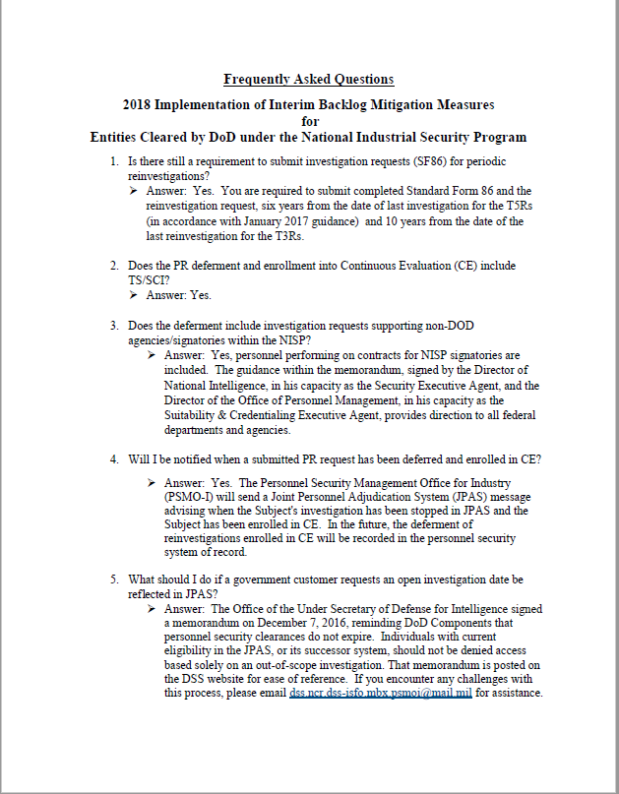
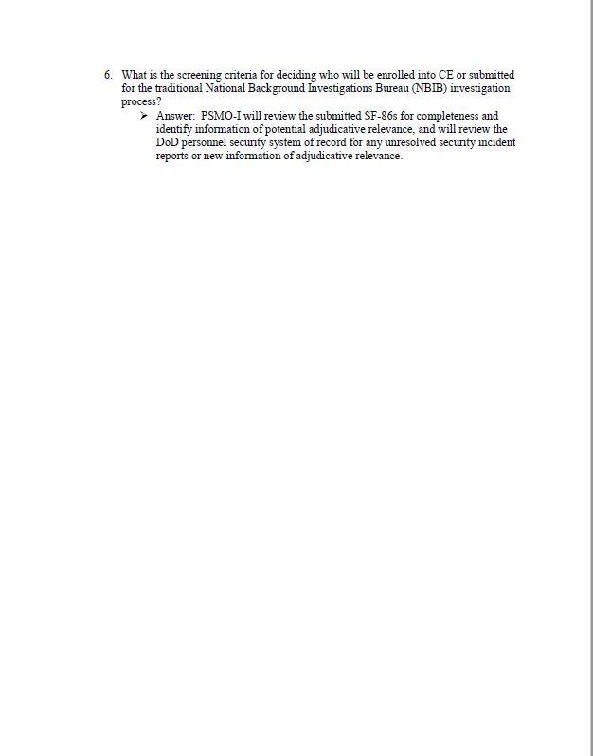
FAQS
LOCKHEED MARTIN PROPRIETARY INFORMATION
Notes:
*Continuous evaluation uses commercial and Gov’t databases to conduct automated record checks to identify adjudicative relevant information to assist in assessing the continued eligibility of a cleared individual at any time
*Implemented numbers are in new cases, not previously enrolled

Slide 19
Expedited Clearance Initiative
(Hubbing)
Robert Afonso
Security Representative Associate

Slide 20
Expedited Clearance Initiative (ECI)
What is ECI?
ECI is a Partnership with National Background Investigations Bureau (NBIB) and approved federal contract vendors to maximize interview time and minimize administrative time (e.g., driving, scheduling) for investigators allowing for reduced wait times for clearances
Most commonly referred to as “hubbing” within NBIB and it’s approved subcontract companies.
The concept of “hubbing” involves a group of investigators being assigned to one central location, working a set of pre-assigned cases that have already been scheduled whether it be VTC or In-person.

Slide 21
Expedited Clearance Initiative (ECI)
Start-up of ECI:
Worked with NBIB to find an approved method for “VTC”. The approved method was our encrypted Lockheed Martin network utilizing Skype for Business video which can only be accessed from within our network.
Partnered with Internal computer engineers to ensure the investigators who would be granted access to our network, would only be able to access programs necessary to complete interviews.
NBIB identified initial investigators who would be working on the pilot program, and sent first set of case names for scheduling.
Secured private offices for investigators to use to conduct interviews.

Slide 22
Expedited Clearance Initiative (ECI)
Scheduling Cases:
Identify a point of contact with NBIB or subcontract agency who will be responsible for assigning cases to investigators once scheduled for them.
Ensure employee understands the requirements for interview (e.g., in-person, vtc, required documents to bring).
If scheduling in a different time zone, talk thru any time differences to ensure employee is on time.
Create a meeting notice between employee and investigator.

Slide 23
Expedited Clearance Initiative (ECI)
Track progress:
Use of internal database to track cases from start to finish.
Record key information such as date case was received, date of interview scheduled, and date interview was complete.
Identified key metrics to evaluate effectiveness of the program, and areas for improvement.
Created internal dashboard to show progress in relation to pending cases.

Slide 24
Expedited Clearance Initiative (ECI)
Lesson’s Learned:
Identify production facilities where employees may have limited access to company assets.
Obtain office space with an asset and a point of contact for employees to utilize if needed.
Obtain a point of contact across all business units who can help facilitate interviews if needed.
Create clear and concise communications for employees.
Include information such as documents to bring to interview, location of interview, and expectation of time to complete interview.
If conducting interview via VTC never assume the employee has a working camera.
We found that just because a laptop has a camera on the screen it may be disabled due to facility requirements.
Best to try to test the connection by having the employee initiated a skype call if possible.

Slide 25
Expedited Clearance Initiative (ECI)
Lesson’s Learned:
When a list is received, review for accuracy (e.g, employee location, employee still employed, clearance level).
Be innovative, Identify ways to increase room productivity, and scheduling efficiency.
Communication is key to success, understand employees/investigators needs or concerns.

